Slide 1

Transmission Based Precautions (TBPs) – Change is coming
Presenter name/title here

Slide 2
What are TBPs
What is changing?
Why is it changing?
What does this mean for IPC practice?
Who does it apply to?
When is it happening?
Where can more info be found?

Slide 3
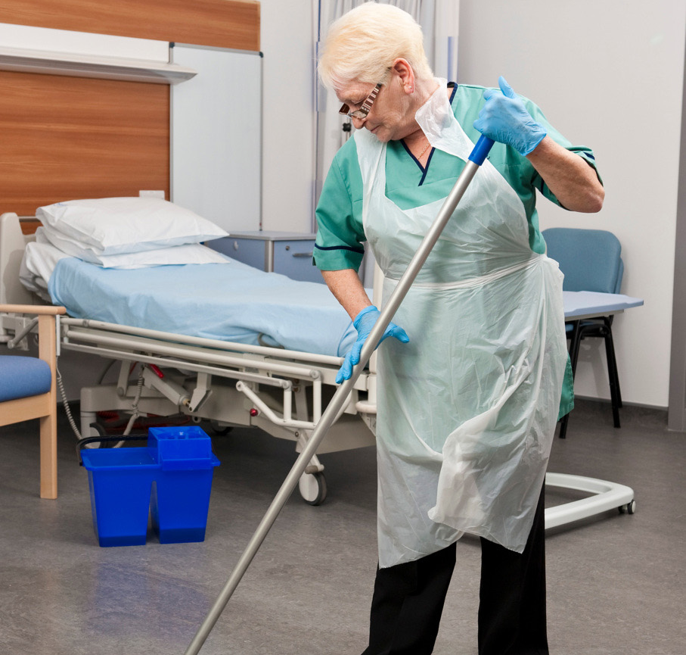
What are TBPs?
Precautions used in addition to Standard Infection Control Precautions (SICPs) when caring for individual with known or suspected infection
All TBPs are important
  Patient placement
  Safe management of the environment
  Safe management of equipment
  Personal Protective Equipment (PPE)
Notes:
TBPs are the controls applied in addition to SICPs when caring for someone with a known or suspected infection or colonisation.
They play a crucial part in preventing the onward transmission of infection to HCWs, patients and visitors.
TBPs guidance is fully outlined in the National IPC Manual produced by ARHAI Scotland and although a lot of the content within these slides focuses on PPE, all components of TBPs are important
TBPs have been applied in health and care settings for decades and it is important you are aware of some planned key changes

Slide 4
What is changing?
Droplet Transmission
Withdrawn
Airborne Transmission
Aerosol Generating Procedures (AGPs)
New descriptors: Contact and Air Transmission
Introduced
Respiratory Categories (R1, R2, R3)
Notes:
The way we describe transmission is changing;
We will no longer refer to droplet, airborne and contact
Instead we will refer to air transmission and contact transmission
Aerosol Generating Procedures (AGPs) will be withdrawn but rather guidance will describe higher risk associated with coughing and high speed devices on the respiratory tract.
Introduction of respiratory categories for respiratory pathogens; R1, R2 and R3

Slide 5
Why is it changing?
Current guidance
Transmission related to particle size & distance only
Large droplets at close range and small aerosols at long range
Doesn’t take account other factors which impact transmission
New guidance
Takes account of multiple factors which impact transmission
Ensures the National Infection Prevention & Control Manual (NIPCM) remains evidence based
Better prepares us for next pandemic
Notes:
Pre-pandemic, and currently in published guidance globally, respiratory transmission was described as occurring by either droplet or airborne transmission.
This was based on particle size cut offs whereby respiratory particles larger than 5 microns were described as large droplets that were only encountered at close range, and particles under 5 microns in diameter were described as aerosols and were encountered at longer range. The descriptors took into consideration what was thought to be the predominant mode of transmission based on particle size.
Whilst this approach provided a simple and straightforward IPC framework it led to fierce challenge and debate during the C19 pandemic with calls to revise guidance.
A review of the evidence undertaken by ARHAI Scotland has demonstrated that these descriptors are no longer fit for purpose.
Supported by findings of C19 Public inquiry
New guidance no longer primarily focuses on particle sizes but also takes account of many other factors which affect exposure and subsequently transmission of infectious agents including, symptoms, environment, vulnerability of HCWs and severity of outcome associated with the pathogen
In no longer applying controls to 2 rigid dichotomies, this will ensure that we are better prepared for the next pandemic.
Internationally, it is recognised that change is needed. In April 2024, the WHO published a global technical consultation report on proposed terminology for pathogens that transmit through the air. Similarly, the US centres for disease control published a draft guideline to Prevent Transmission of pathogens in healthcare settings. The findings of WHO and USCDC are closely aligned to that of new guidance.
WHO. Apr 2024. Global technical consultation report on proposed terminology for pathogens that transmit through the air https://www.who.int/publications/m/item/global-technical-consultation-report-on-proposed-terminology-for-pathogens-that-transmit-through-the-air
CDC. Nov 2023. DRAFT 2024 Guideline to Prevent Transmission of Pathogens in Healthcare Settings. Available online at https://stacks.cdc.gov/view/cdc/134943
Scotland will be the first country globally to launch this change.

Slide 6

What does it mean for IPC Practice?
General points (Fluid Resistant Surgical Mask or Respiratory Protective Equipment):
  Selection based on R Category
  Must be donned on entry to room
  Sessional use in cohorts
Notes:
There are some general changes to the application of fluid resistant surgical masks and respiratory protective equipment
Selection of mask type will now be undertaken using an algorithm which uses new respiratory categories as a foundation for risk assessment.
Masks should be donned before entering the room, and doffed after exiting the room of the individual being cared for. This helps protect against any long range transmission risk. This does not apply to FRSMs worn as part of SICPs for exposure to anticipated splash or spray of body fluids – in these cases FRSMs should be removed when exposure risk ceases.
Masks may now also be worn sessionally if caring for individuals within a respiratory cohort. No need to change between patients unless contaminated or damaged.

Slide 7

What does it mean for IPC practice?
Fluid Resistant Surgical Masks (FRSM)
  For R1 pathogens
  Worn when pathogen unknown
  Worn when providing care to immunocompromised individuals
  Worn by immunocompromised individuals when leaving protective isolation room
  Extended use by HCWs, Patients and Visitors during epidemic/high rate of local transmission
Notes:
FRSMs should be worn for care of individuals with known or suspected R1 pathogen: table on slide 9 describes in more detail.
FRSM should also be worn on initial presentation if respiratory pathogen unknown unless there are pre assessment indicators which suggest a suspected R2 or R3 pathogen
FRSM should be worn when caring for individuals who are immunocompromised and who require protective isolation. The individual within protective isolation should also wear FRSM if asked to leave their room.
During epidemics or periods of high rate of local transmission extended use of FRSMs by HCWs, visitors and patients will be advised

Slide 8
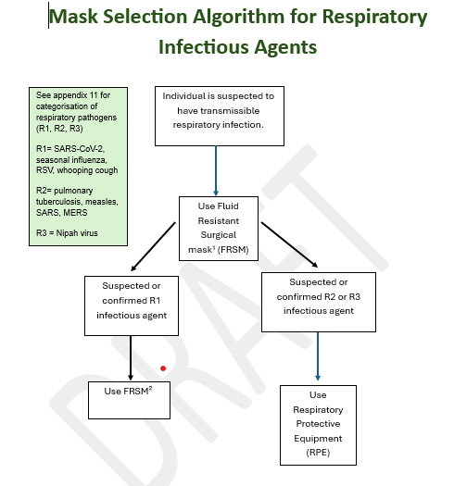
What does it mean for IPC practice?
Respiratory Protective Equipment
  Worn for R2 and R3 pathogens
  Worn for R1 pathogens
    If advised to do so by personal medical practitioner due to risk of severe outcome
    Personal choice (informed by awareness of risk)
Notes:
RPE should be worn if providing care to an individual with a suspected or confirmed R2 or R3 pathogen.
May also be worn for R1 pathogens if advised by HCWs own medical practitioner or as a personal choice.
Personal choice to wear RPE currently exists as DL (2022) 10.
FFP3 respirators are the most common type used in healthcare. HCWs MUST be Fit tested prior to donning RPE and perform a fit check each time it is donned. Powered respirators may be used as an alternative if a successful fit test cannot be achieved.
A mask algorithm will be published to support mask selection.

Slide 9
What does it mean for IPC practice?
Category (example pathogens) | Placement Requirements | Mask Type
R1 (Bordetella pertussis, RSV, SARS-CoV-2, Endemic Influenza) | Single en suite room | FRSM*
R2 (Varicella zoster, Pulmonary Tuberculosis, Measles virus, some HCIDs) | NPIR or PPVL or Single en suite room | RPE
R3 (some HCIDs, Novel respiratory virus) | NPIR or PPVL in an IDU | RPE
*Option to wear RPE for R1 pathogens;
  If advised to do so by personal medical practitioner due to risk of severe outcome
  Personal choice (informed by awareness of risk)
Notes:
Table on this slide lays out some of the pathogens within each respiratory category.
Staff can refer to Appendix 11 which will contain the R category for all respiratory pathogens
The table outlines the corresponding patient placement requirements and mask requirements
It should be noted that TBP guidance does not replace the HCID guidance laid out in the HCID addendum of the NIPCM.

Slide 10
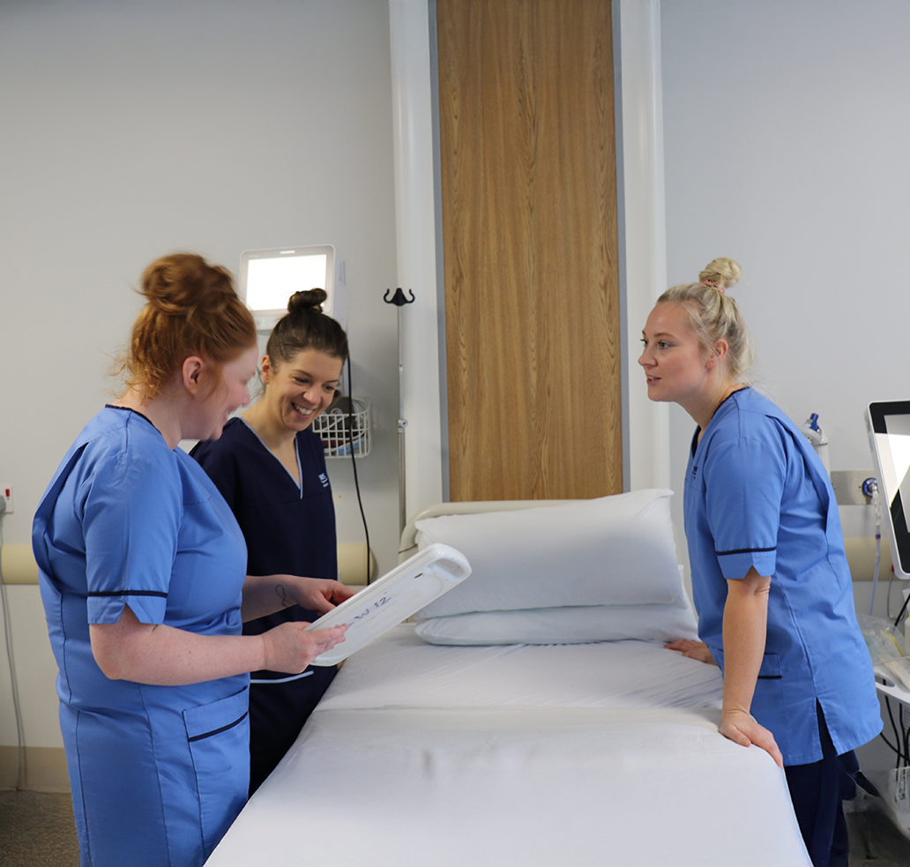
Who does it apply to?
  Any staff member who does or may provide care to an individual with suspected or confirmed infection
  The NIPCM is considered best practice across all health and care settings
  IPC is not setting specific; IPC applies across all settings
Notes:
The new guidance will apply across all health and care settings

Slide 11
When is it happening?
  New guidance launch 3rd August 2026
    NIPCM content
    Supporting resources
    NHS National Education for Scotland (NES) Turas Module
Notes:
The new guidance will be launched in August 2026 inclusive of;
New content within body of TBP chapter
Mask algorithm
What’s changed document with key links
FAQs
Posters
The literature reviews and considered judgement forms will also be published detailing the evidence and discussion at the working group which informed the content.

Slide 12
Where can more information be found?
  National Infection Prevention and Control Manual (NIPCM)
  Your local Infection Prevention and Control Team (IPCT)

Slide 13
Thank you

